Slide 1
Trainer Management System (TMS)
End-to-End journey

Slide 2
TMS Slide deck contents
Product overview
Training journey
Demo
Self-reflection

Slide 3
Product overview

Slide 4
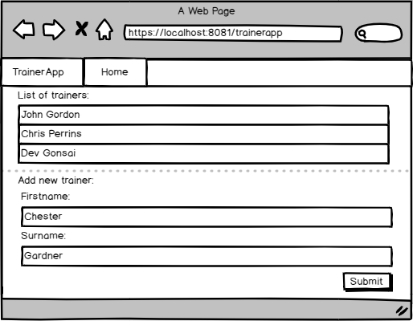
List of trainers
As a training manager,
I want to see a list of people available,
So that I can assign appropriate trainers to classrooms

Slide 5
Add trainer
As a training manager,
I want to add new people to my list of trainers,
So that I can meet the demand of our customers

Slide 6
Demo: How did I manage my project?
To demonstrate to the audience how I managed my project.
Navigate to the following URL: https://trello.com/b/hYFjd4AA/training-application

Slide 7
Training overview

Slide 8
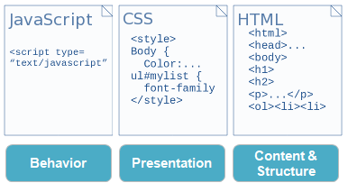
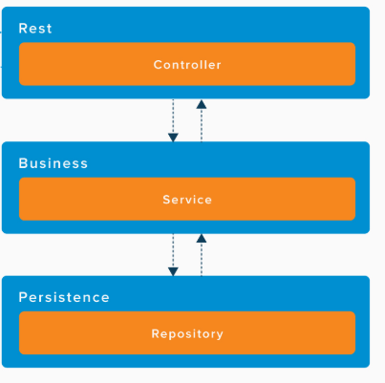
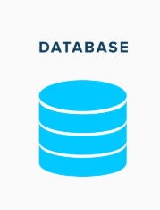
The Architecture
Front-end
Spring Boot API
Database

Slide 9
Demo: How did I create my project?
To show the audience how I developed my project on Github.
Navigate to the following URL: https://github.com/scrappy1987/nbs-trainer-example

Slide 10
Demo

Slide 11
Demo: What does my project look like?
To show the audience the product I’ve built so far.
Navigate to the following URL: http://localhost:8081

Slide 12
Self reflection

Slide 13
What went well during the project?
Personal
I completed my project estimates
Collaboration and team problem solving
Self-reflection and celebrating success
Managing personal stress
Technology
Java & OOP
Spring boot & API’s
Tools that make my life easier like Balsamiq

Slide 14
What didn’t go so well during the project?
Personal
At the start of the academy I wasn’t managing my time very effectively
On occasion, I found it difficult to ask questions due to embarrassment
Technology
Web design
Integrating the front and backends

Slide 15
What would I like to do in the future?
Features
Trainer removal feature
Trainer update feature
Navigation system
Additional Trainer skill sets page
Move trainer creation to it’s on page
Technology
Automated tests with selenium
>80 unit test coverage
Use a library or framework like SpringBoot

Slide 16
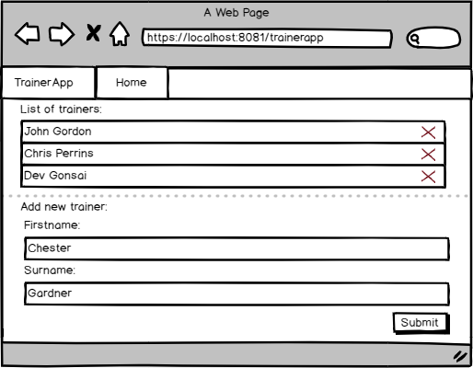
Delete trainer
As a training manager, I want to delete people from my list of trainers, So that I can manage my roster when members leave the team

Slide 17
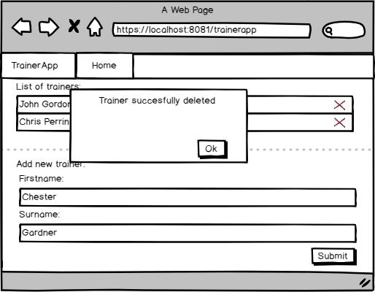
Delete trainer
Acceptance criteria:
Given I am on the trainer list page, When I have no trainers in my system, Then I'm not presented with any function to delete
Given I am on the trainer list page, When I have one trainer in my system, And I press the delete icon, Then all trainer data is removed, and I'm presented with a pop-up that says "Trainer Successfully deleted”
Given I am on the trainer list page, When I have two trainers in my system, And I press the delete icon on the second trainer, Then I will only see one trainer and I will be presented with a pop-up that says "Trainer Successfully deleted"

Slide 18
Demo: How will I use this experience for my CPD?
To show the audience an example of my backlog and how it’s evolving.
Navigate to the following URL: https://trello.com/b/hYFjd4AA/training-application

Slide 19

Thank you for listening
Any questions?

